Slide 1
Mini-Project: SQL - From Data to Insight
Bart and Matthew
22.01.24-26.01.24 (DA Week 3)

Slide 2
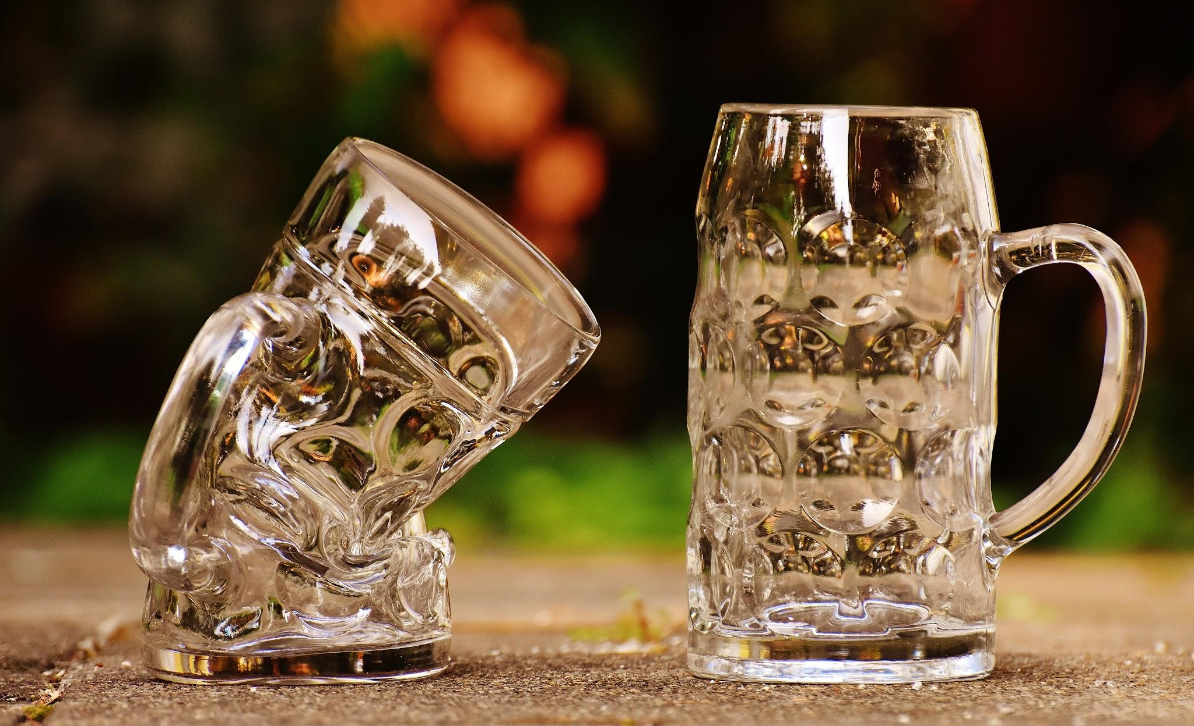
We’d like to understand what drives beer consumption at Oktoberfest

Slide 3
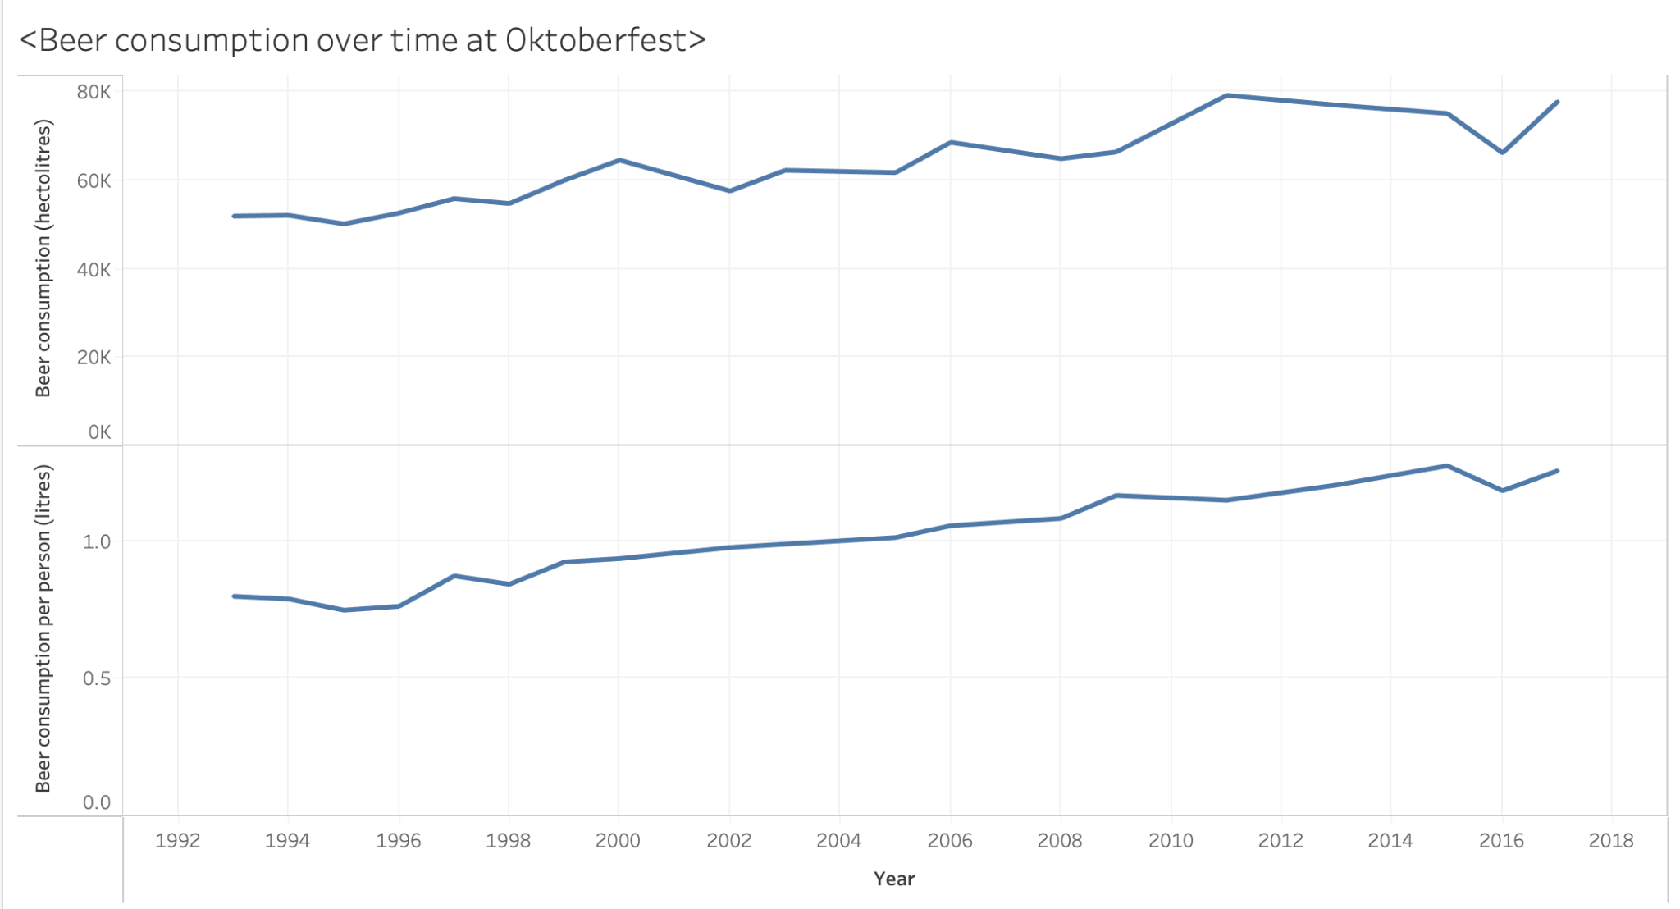
General trend: beer consumption at Oktoberfest is increasing
Source: Kaggle

Slide 4
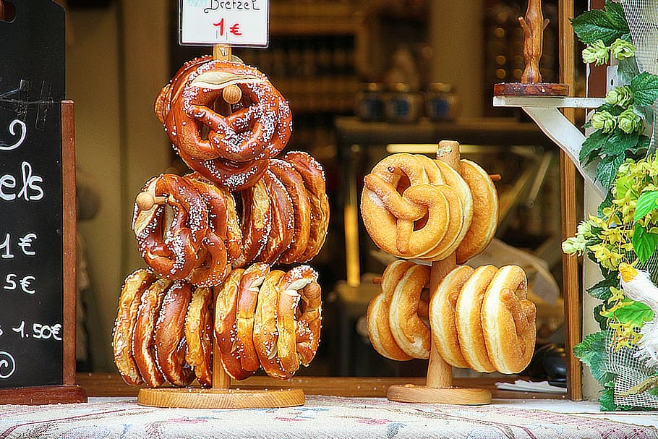
Which variables might drive beer consumption at Oktoberfest?
FESTIVAL FACTORS
Price of beer
Number of visitors
Chicken consumption
ECONOMIC FACTORS
Inflation rate in Germany
CULTURAL
How FC Bayern are performing (as measured by number of goals scored in the month of September)
NATURAL
Weather
(as measured by mean temperature in Munich in September)

Slide 5
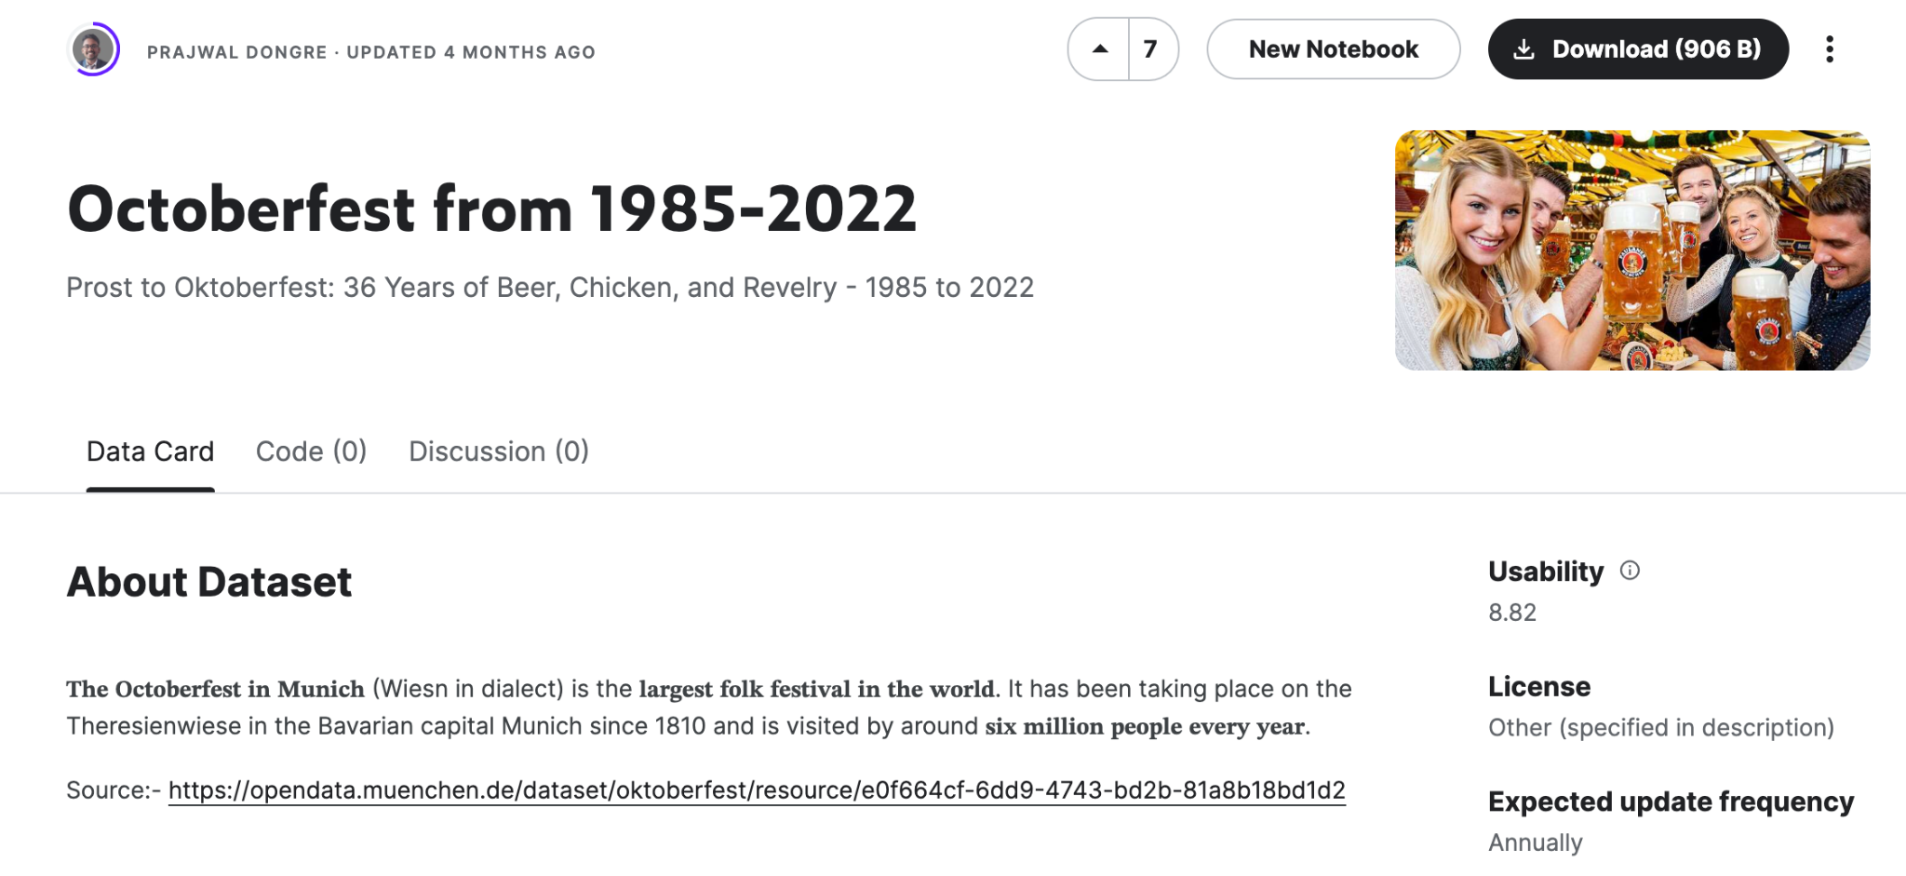
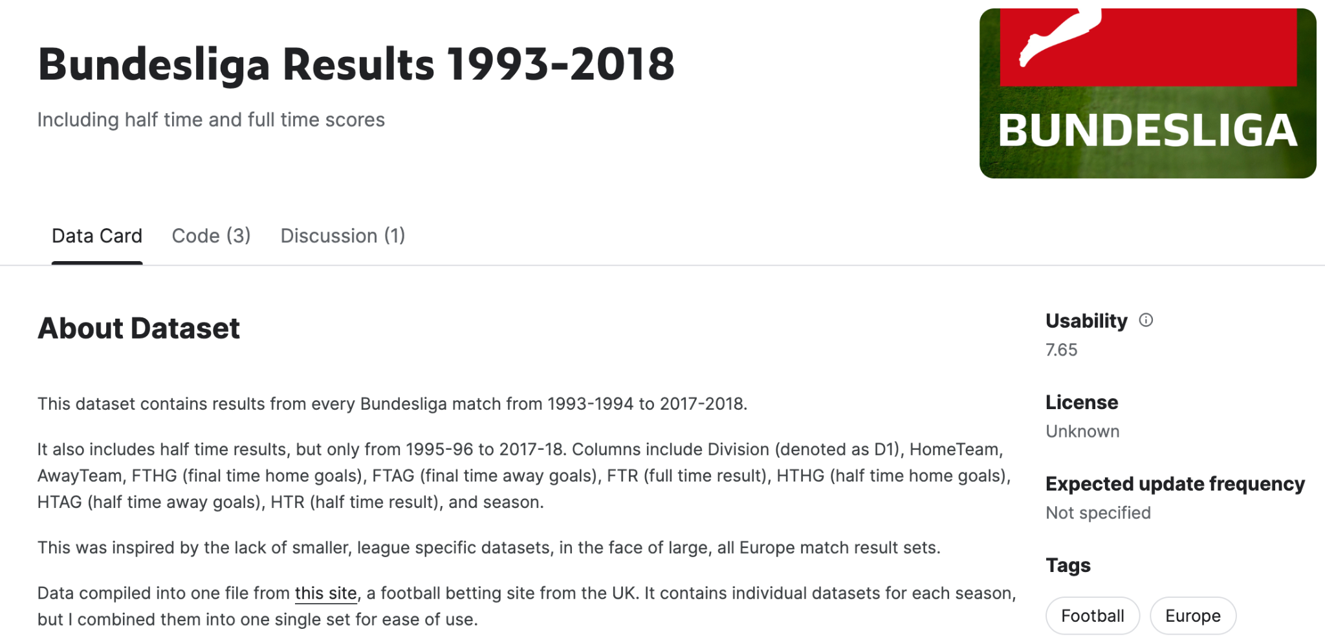
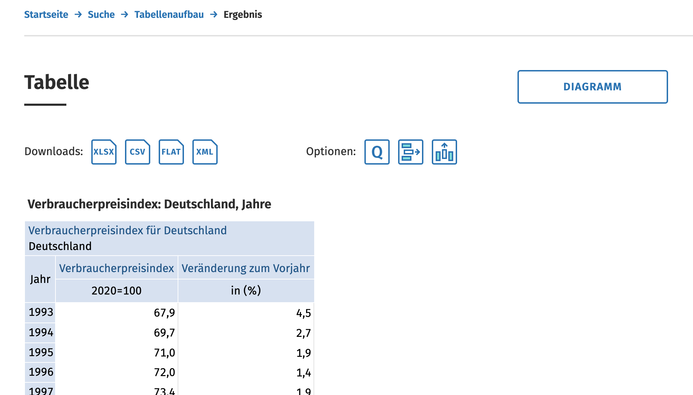


We looked at 3 data sources
Source: Kaggle
Source: Kaggle
Source: genesis-destatis
1985-2022
1993-2018
1985-2022
Required filtering

Slide 6

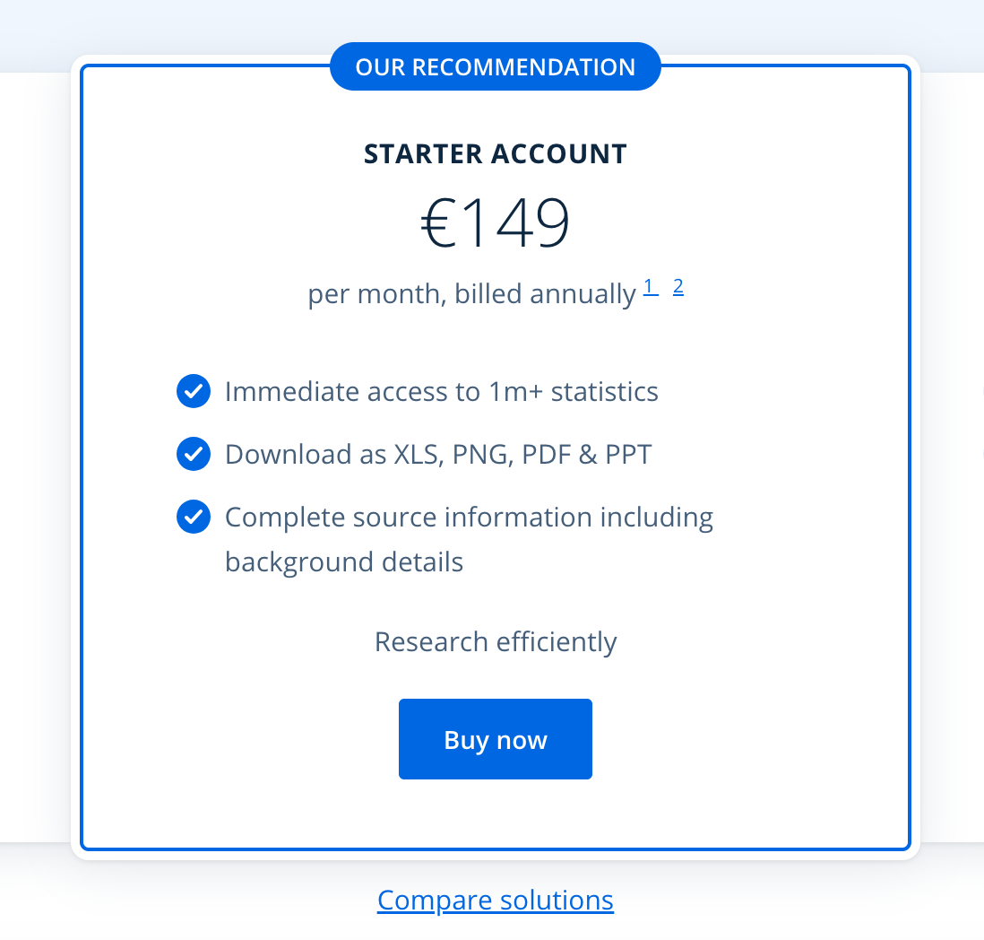
We wanted to look at a 4th data source
Mean temperature in {Munich} or {Germany} by {month} or {year}
BLOCKER: Unable to find sufficiently comprehensive data for free
TAKE-AWAY:
Seemingly simple data-sets can be hard to
come by
Can be time-consuming searching for the right data-set

Slide 7
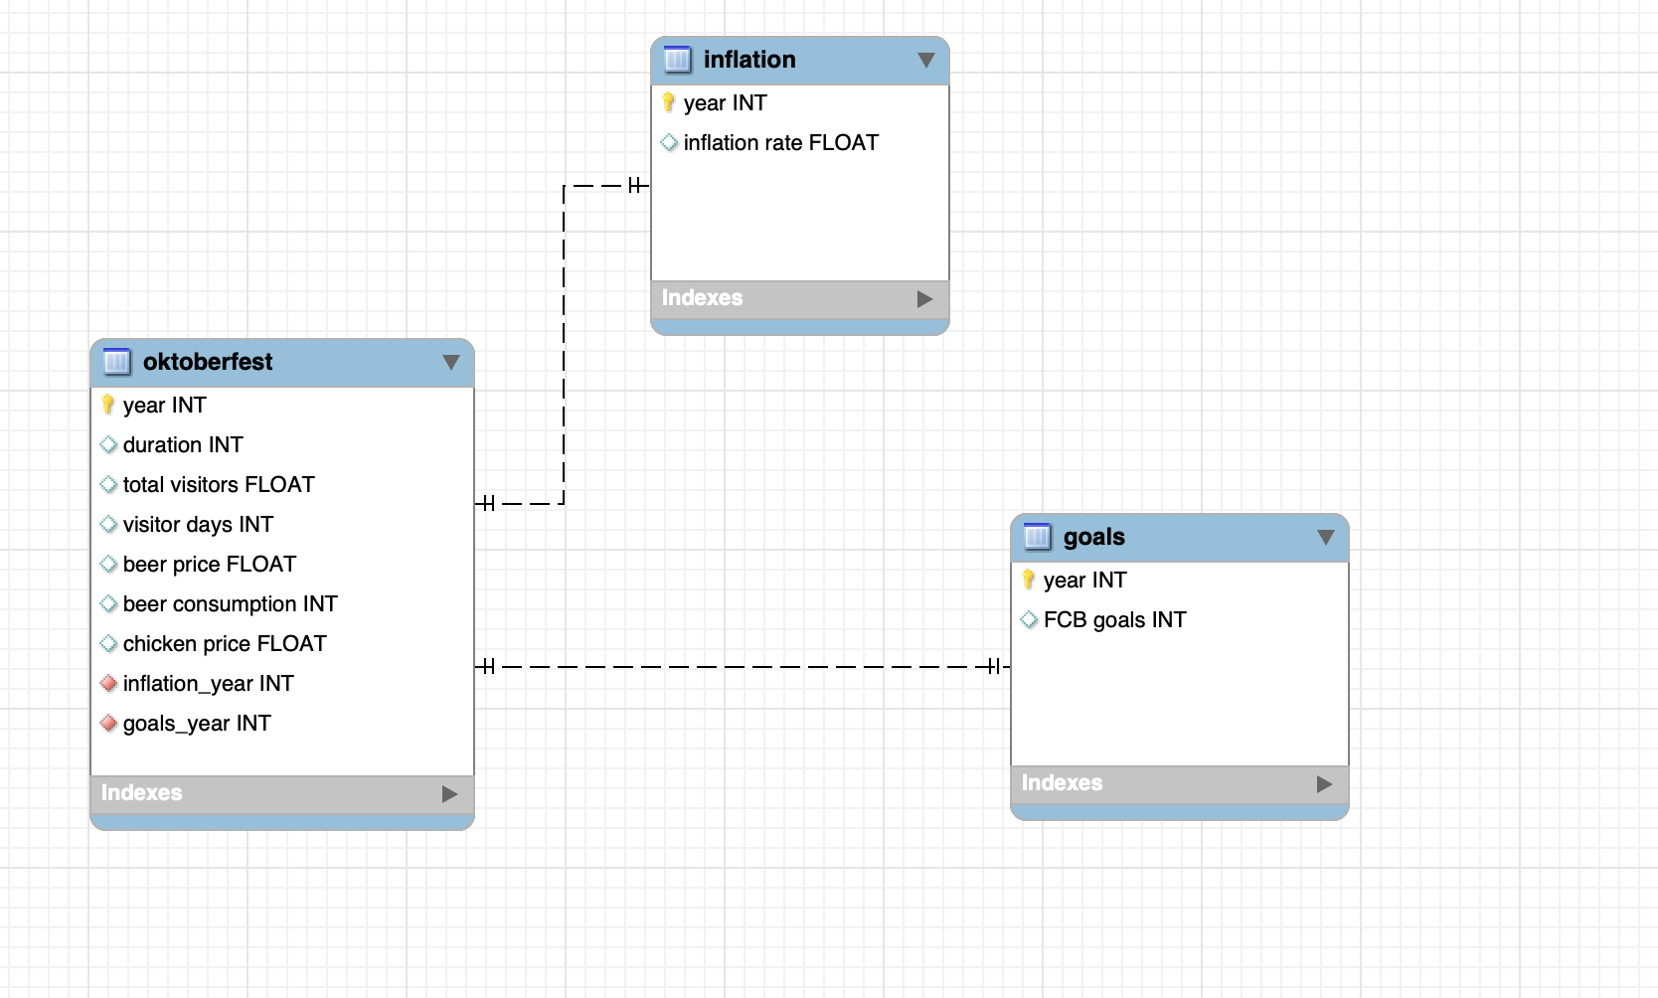
From our 3 datasets, we built a schema
Source material

Slide 8
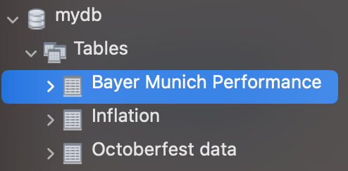
We forward engineered schema (mydb) to MySQL workbench

Slide 9
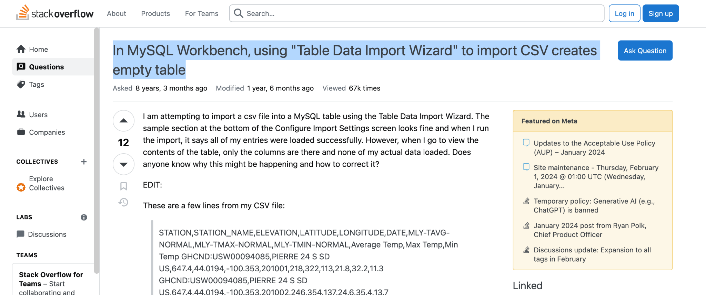
We wanted to populate schema from CSVs

Slide 10
While troubleshooting on SQL, we ran analyses on Jupyter Notebook
merged our 3 tables into one ‘super-table’
merged_df_inner = pd.merge(df1, df2, on='key', how='inner')
ran correlation analysis on our chosen variables against data for beer consumption
correlation_{variable} = df['{variable}'].corr(df['Beer_consumption'])

Slide 11
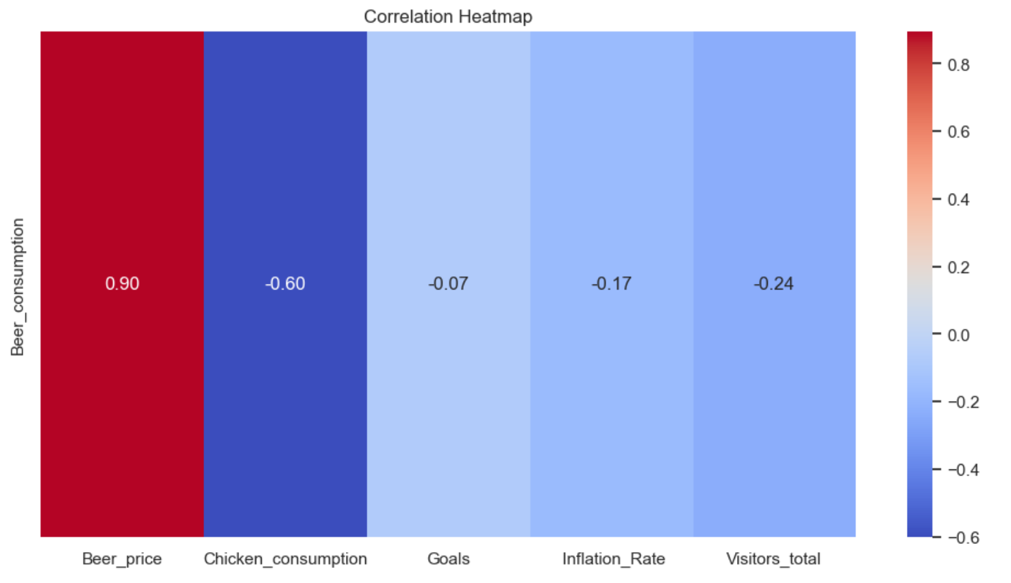
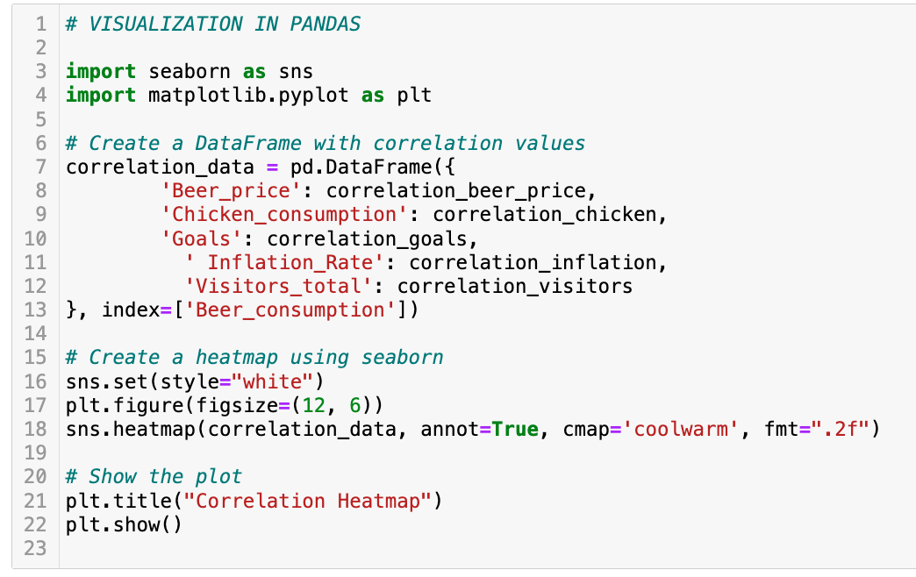
While troubleshooting on SQL, we ran analyses on Jupyter Notebook

Slide 12
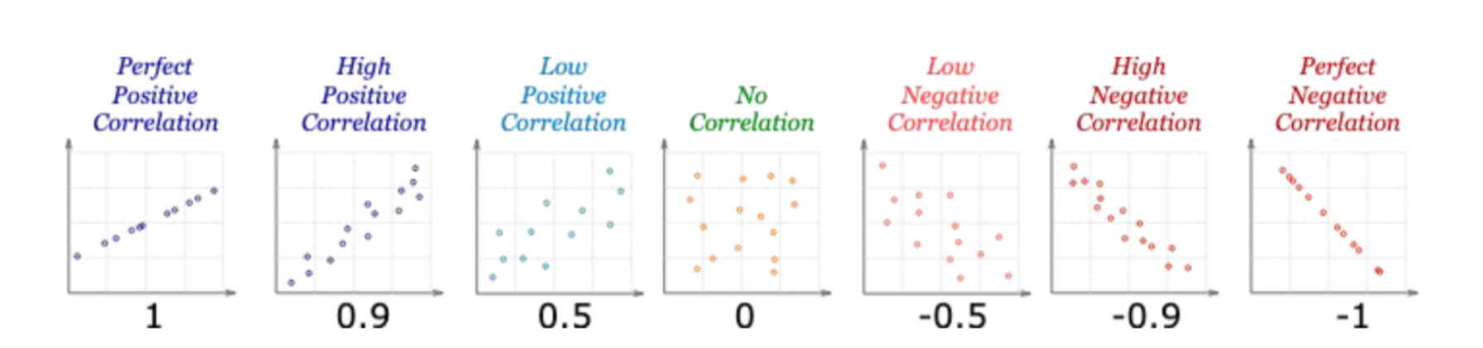
Correlation: Guide

Slide 13
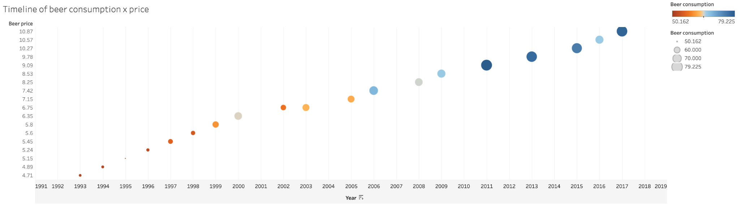
High positive correlation: beer price

Slide 14
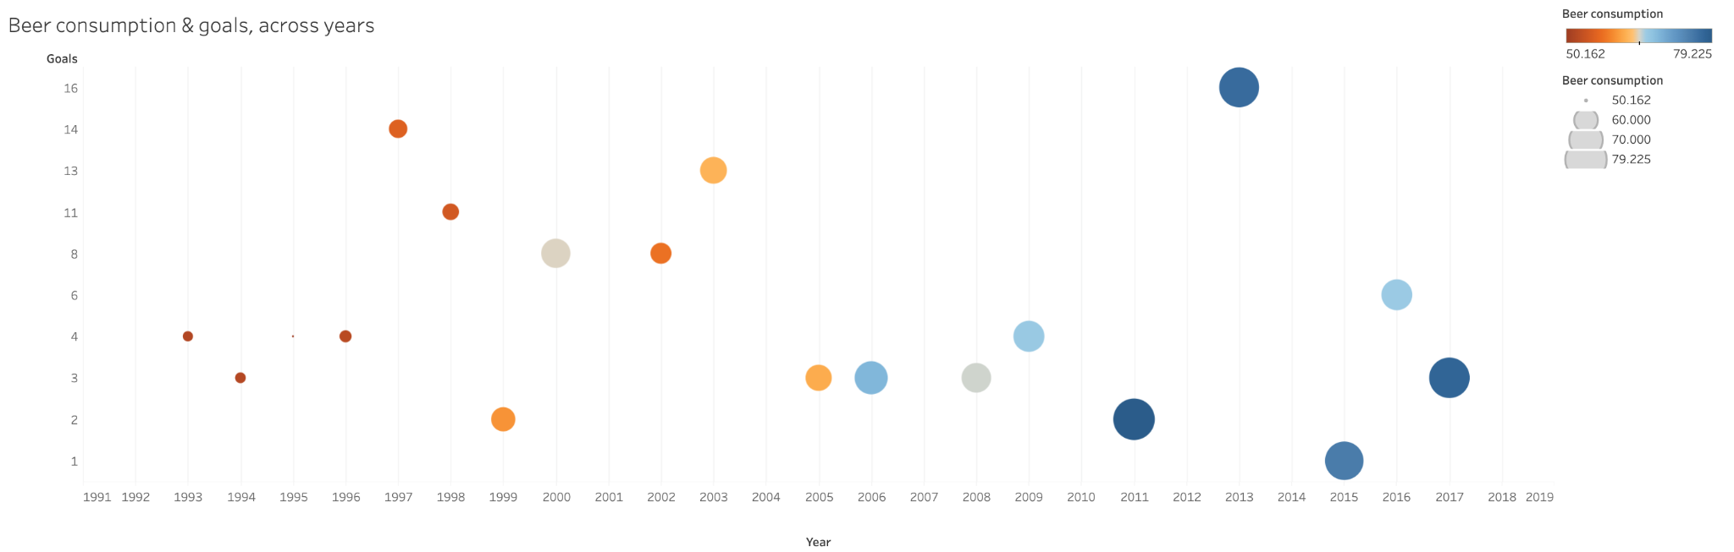
No correlation: FC Bayern goals

Slide 15
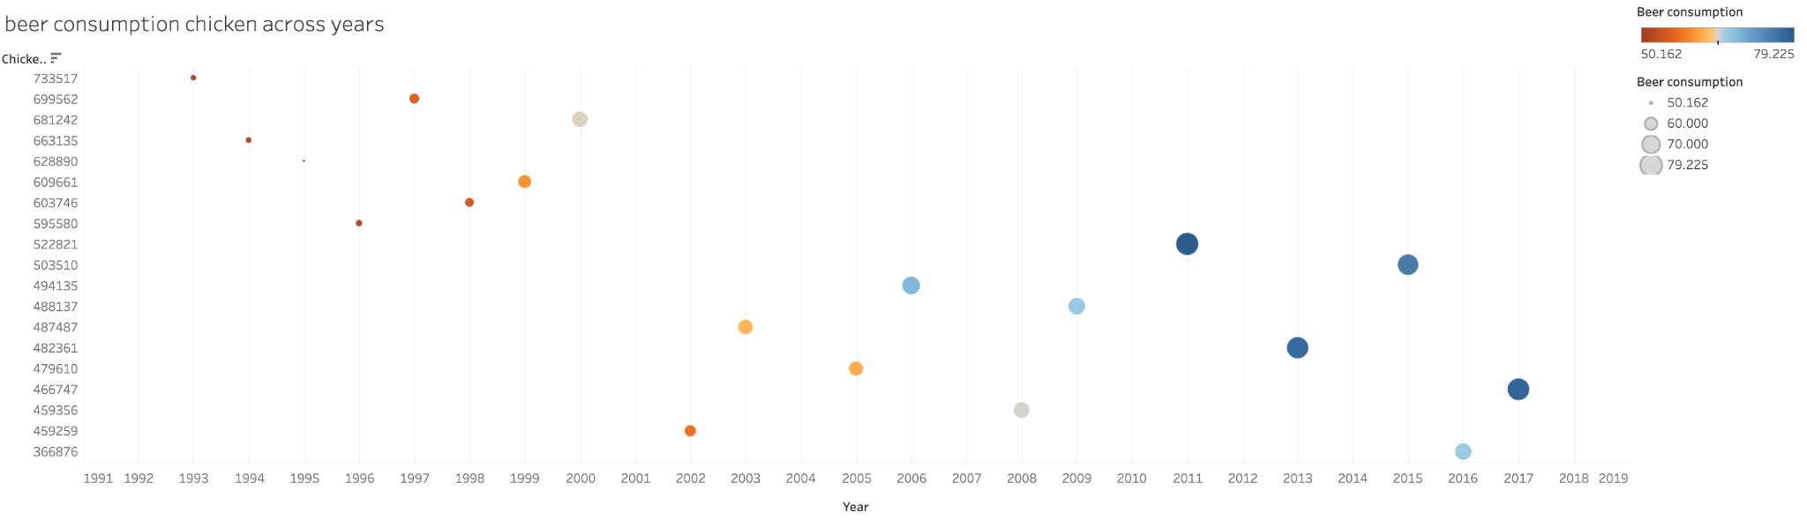
Low negative correlation: chicken consumption

Slide 16
Challenges with Tableau
aligning data types across tools - floats in python became strings in Tableau
inhibited further visualisation such as running animation

Slide 17
Conclusion
only one variable (beer price) correlated to beer consumption (but relationship inverse to that which was expected)
this investigation would need to draw on more societal variables (e.g. overall drinking habits)
working with data across multiple tools was more time-consuming than expected; this was to the detriment of our ability to analyse and potentially introduce more variables

Slide 18
Feedback following presentation on 26.01
would be useful to analyze ‘purchase power’ as beer price inflation YoY vs inflation YoY; it could be that beer is becoming relatively cheaper, which drives consumption
schema could be simplified to one table in this instance as there is little value in the additional tables

